Slide 1

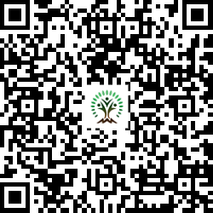


IONIQ Forest
Grid – A Zones 1 -10

Slide 2
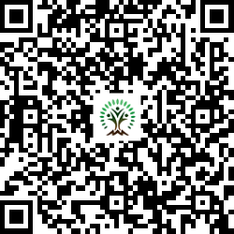
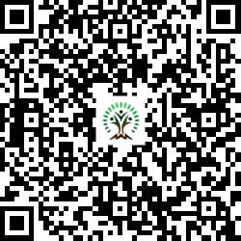
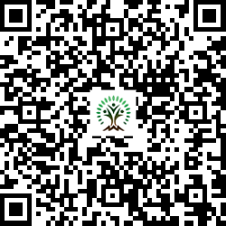
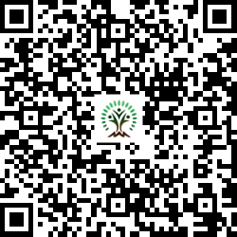
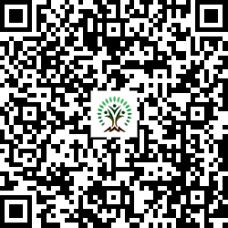
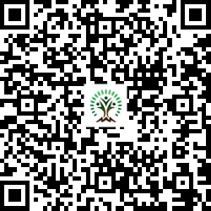
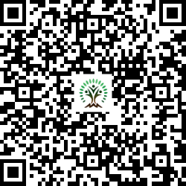
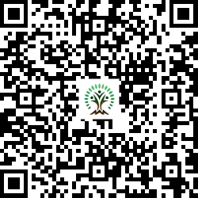
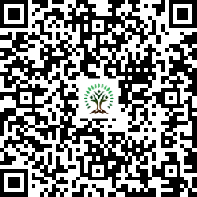
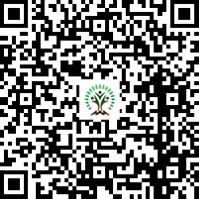
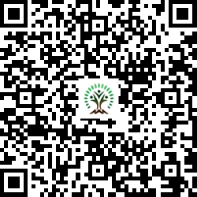
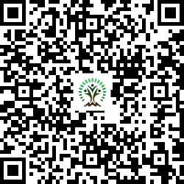
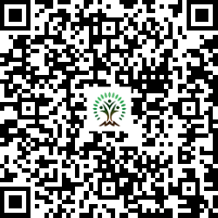
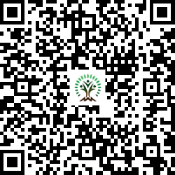
Sr. No. | Scientific Name | Common Name | QR Code
1 | Aegle marmelos | Wood Apple
2 | Alstonia scholaris | Blackboard Tree
3 | Azadirachta indica | Neem Tree
4 | Bauhinia variegata | Kachnar, Orchid Tree
5 | Bombax ceiba | Silk Cotton Tree
6 | Butea monosperma | Flame of the Forest
7 | Cassia fistula | Golden shower tree
Sr. No. | Scientific Name | Common Name | QR Code
8 | Dalbergia sissoo | Indian rosewood
9 | Ficus racemosa | Cluster fig
10 | Holarrhena pubescens | Ivory tree
11 | Lagerstroemia speciosa | Pride of India
12 | Limonia acidissima | Wood Apple
13 | Melia dubia | Malabar Neem
14 | Morus nigra | mulberry

Slide 3
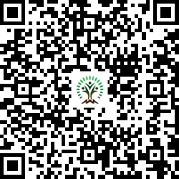
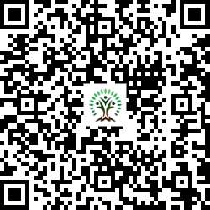
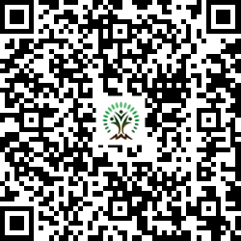
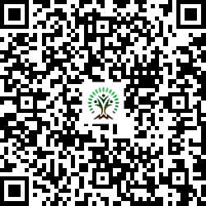
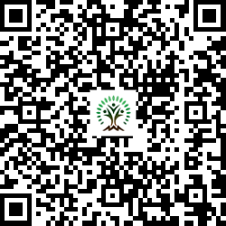
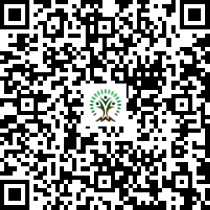
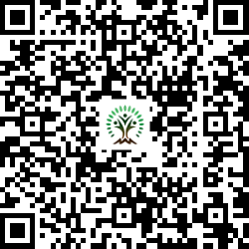
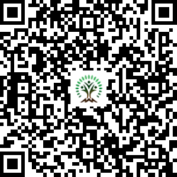
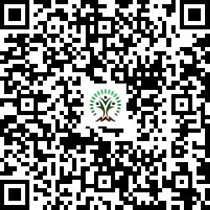
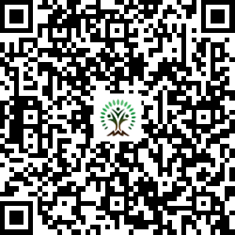
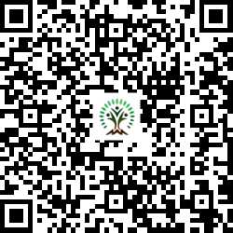
Sr. No. | Scientific Name | Common Name | QR Code
15 | Neolamarckia cadamba | Burrflower tree
16 | Phyllanthus emblica | Indian gooseberry or amla
17 | Pongamia pinnata | Indian Beech Tree
18 | Psidium guajava | Guava
19 | Syzygium cumini | Java plum, Jamun
20 | Tamarindus indica L. | Tamarind
21 | Terminalia arjuna | White Murdah
Sr. No. | Scientific Name | Common Name | QR Code
22 | Terminalia bellirica | Beach almond
23 | Thespesia populnea | Indian tulip tree
24 | Toona ciliata | Indian mahogany
25 | Acacia catechu | Black Cutch Tree

